Slide 1

Fablab course on sewing machines
April 19th, 2026 13.00 – 18.00

Slide 2
Participants, presentation
Jean-Paul Superuser
Emil Superuser
Silvia
Maye
Turjja
Alexander
Karl
Look for other participants and set groups of two persons.

Slide 3
Schedule
Introduction, presentation and groups 13.00-13.20
Sewing machine mechanics 13.20-13.50
Exercise 1 Sewing speed and evaluation 13.50-14.30
Break 14.30-14.40
Sewing machine needles 14.40-15.25
Sewing machine preparations and checklist 15.25-16.00
Break 16.00-16.10
Sewing machine threads 16.10-16.30
Exercise 2 Sewing two layers Tarpauline and Serafil 40 16.30-17.00
Typical fabrics and sewn things 17.00-17.20
Exercise 3 Sewing with Serafil 20 17.20-18.00

Slide 4
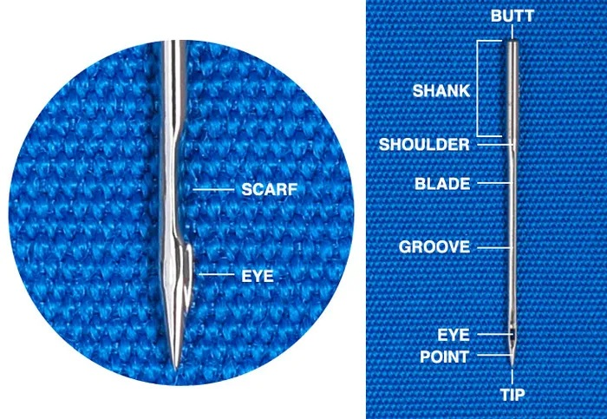
Sewing machine mechanics

Slide 5
Sewing machine mechanics
Hand out needles, fabric and thread
Look how loop of thread is formed

Slide 6
Sewing machine mechanics
3 sewing machine needle sizes
Be aware how needle size change centre position
Discus what may go wrong?
Needle bended
Needle friction cause presser foot to lift
Fabric is stretchable
Too big holes in needle plate and presser foot. Hole for zig-zag.
Hook position not stable (Husqvarna)
Hook
Bottom of scarf

Slide 7
Sewing machine mechanics
Try to pull in the thread like the hook do. Feel thread friction
Move needle up so needle eye is in fabric. Feel thread friction
You need to have a smooth thread U-turn at hook. Show Pfaff 30 hook.
You need to have a smooth needle eye and other surfaces against the thread

Slide 8
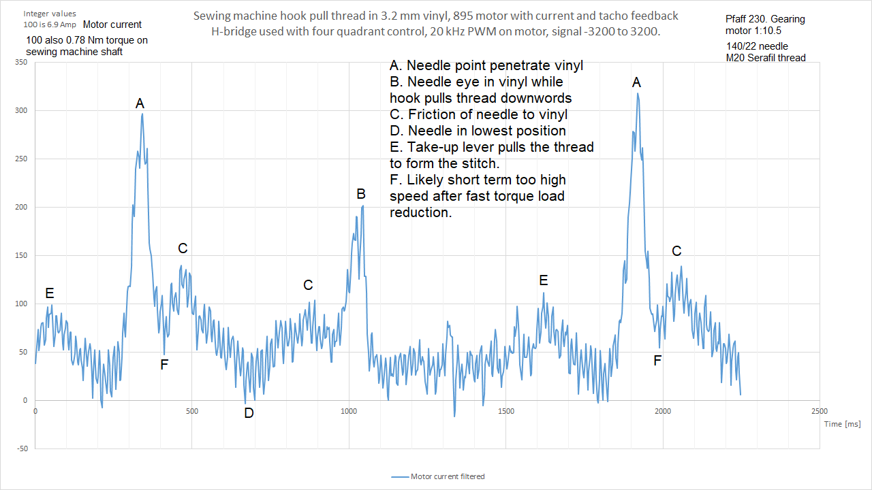
Sewing machine needles

Slide 9
Long Shuttle Sewing Machines
The old long shuttle sewing machines did not have this problem, because they had some more advanced movement of the needle
https://www.youtube.com/watch?v=hbKdmW3Yjt4
The long shuttle machines cannot sew fast due to vibration, and they are more expensive to produce. They got only straight stitch.
Their advantages:
Less thread wear by sewing machine Can sew with both thinner and thicker thread
Can sew with lower thread tension for delicate fabrics
One Pfaff 11 handcrank machine is here. Try it if you got time.

Slide 10
Vintage sewing machines
I had a video about it in the preparation. I got these extra comments
You like to have reverse stitching and full reverse stitch length
You like to have the possibility to change presser foot pressure
Both straight stitch and zik-zak stitch are good options
You may check the possibility to get a replacement stitchplate
You like to have a motor and the possibility to set another motor on it
Possible household machines: Pfaff 130, Singer 201, Pfaff 30, Singer 237
Just now dba: Pfaff 130 200 kr. Pfaff 230 250 kr, Singer 237 350 kr, Pfaff 30 750 kr, Bernina 117 1550 kr,

Slide 11
Basic safety principles
Use your hand on the handwheel, when you sew your first stithes on something to get a feeling on how much force is needed. By hand you will normally feel if something is wrong and needs to be corrected.
Only turn the machine forward and only backwards max ¼ of a turn if needed.
Only turn on power to the machine when needed. It is good for your safety when power is off.
Use the start checklist below when you need to use the machine for something.
Don’t put your fingers in harms way.

Slide 12
Basic safety principles
6. You are only allowed to use the motor on the machine given the conditions in the table below. Otherwise, you can damage the machine or get thread jams:
Presser foot | Fabric under presser foot | Needle thread in needle and take-up lever | Bobbin thread in machine | Is machine allowed to work?
Up | Don’t care | Yes | Don’t care | No
Up | Don’t care | Don’t care | Yes | No
Down | No | Don’t care | Don’t care | No
Down | Yes | No | Yes | No
Down | Yes | Yes | No | No
Down | Yes | No | No | Yes
Up | Don’t care | No | No | Yes *
Down | Yes | Yes | Yes | Yes **
*Used for bobbin winding
**Used for normal sewing

Slide 13
Sewing machines here exercise 1
Brother Innov-is 100 Group 1 & 3 Modern household zik-zak sewing machine with computer.
Veritas PowerStitch Pro Group 2 & 4 Modern household zik-zak sewing machine. Announced to be good for heavy duty applications.
Singer 201K, modified Group 3 & 1 Vintage straight stitch household sewing machine. Famous. Produced 1935 to 1961. This one is from 1950.
Dürkopp 291, new motor drive Group 4 & 2 Industrial triple feed sewing machine. Produced about 1985.

Slide 14
Speed control evaluation excersise
Get used to pedal and speed ½ minut each with nothing under foot and no sewing thread. The Brother machine needs some fabric.
The aim is to evaluate the speed control of the sewing machine. Stitch length is set to 4 mm. You are not allowed to reposition the fabric under the presser foot but turning it is allowed. You are not allowed to use the handwheel. You are allowed to start and stop the machine and change speed with pedal.
Excersise 1: You need to follow a straight line, a curve and a straight line on a cartboard.
Excersise 2: You need to sew down to a line and turn on corner. Try to hit the corner with needle. And sew a bit again along edge.
Excersise 3: Measure lowest possible speed (stitches/min).

Slide 15
Speed control evaluation excersise
Please share with others here your experience
Unfortunately, it is almost impossible to get specifications on lowest speed regarding sewing machines nor servo motor drives. You need to ask about it, search for the information or try the machine before buying.
https://www.youtube.com/watch?v=i552XIOQFDY
I see 90 stitches/min lowest speed in this video
The pedal and the electronics used sets this performance
Break 10 min

Slide 16
Sewing machine needles
Needle system
It is a hidden specification regarding key dimensions of the needle. The needle system can be found in the sewing machine manual. Europe, USA and Japan got their own way of naming needle systems. Therefore, each needle system got more names.
There is about 1000 needle systems. 130/705H is only one of them.
Needle size
Refer to the diameter of the shaft (blade)
Other specialities like needle point, size of needle eye etc.

Slide 17
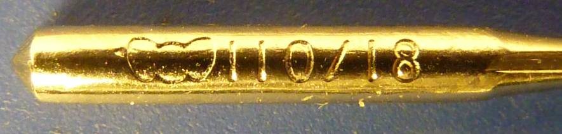
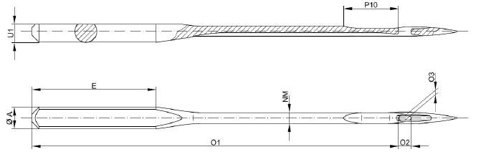
Sewing machine needles, size

Slide 18
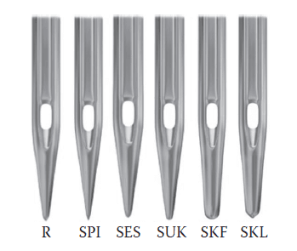
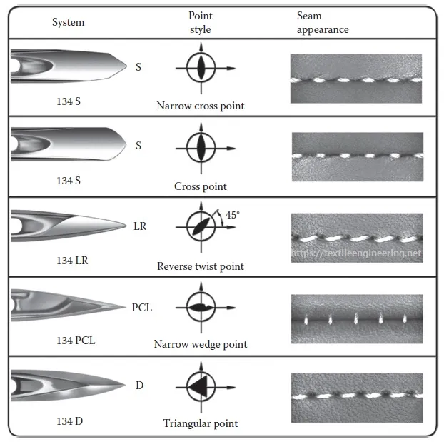
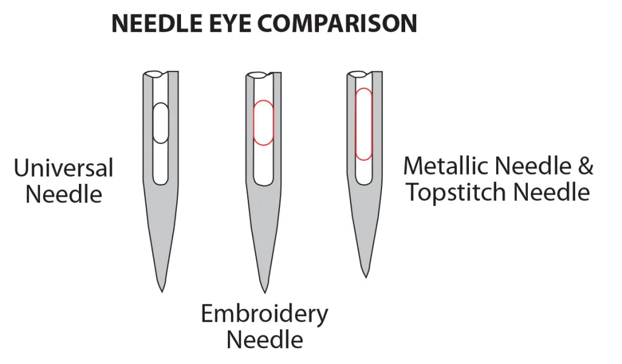
Sewing machine needles, point, eye

Slide 19
Sewing machine needles, Household
99% of all household sewing machines use the same needle system
Names:
130/705H (European) (Previous: 130B, 130R, 705)
15x1 (USA)
HAx1 or HA-1 (Japan) SY2020 (Singer)
They got a flat side on the shank. The others are normally round
You can get them from size 60/8 to size 140/22.

Slide 20
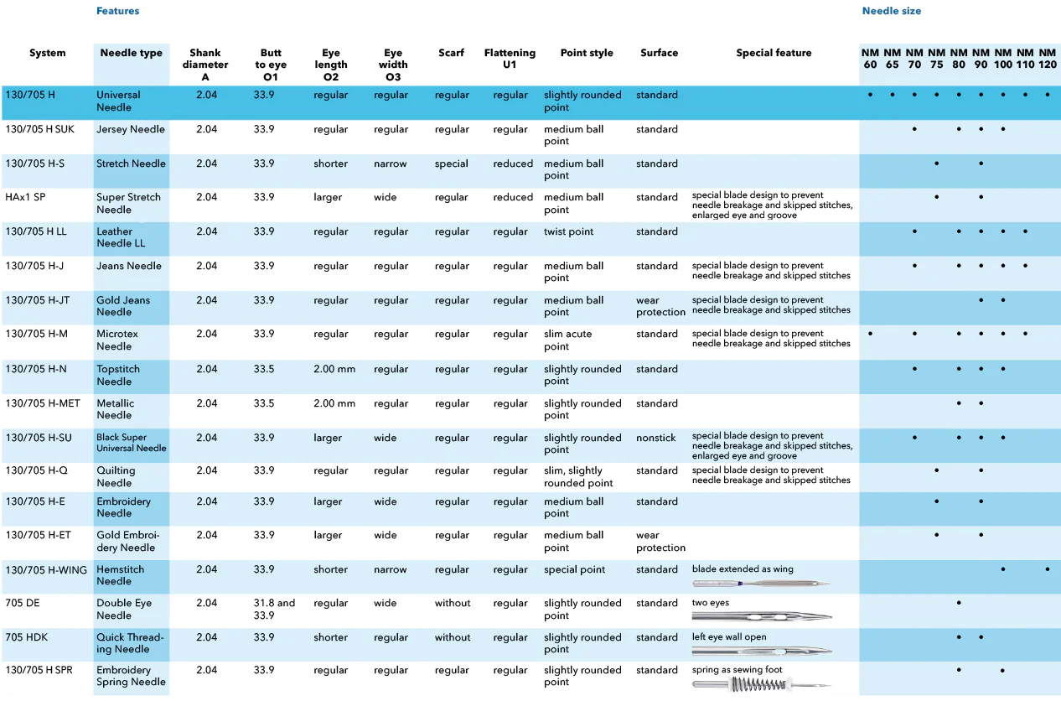

Sewing machine needles, Household

Slide 21
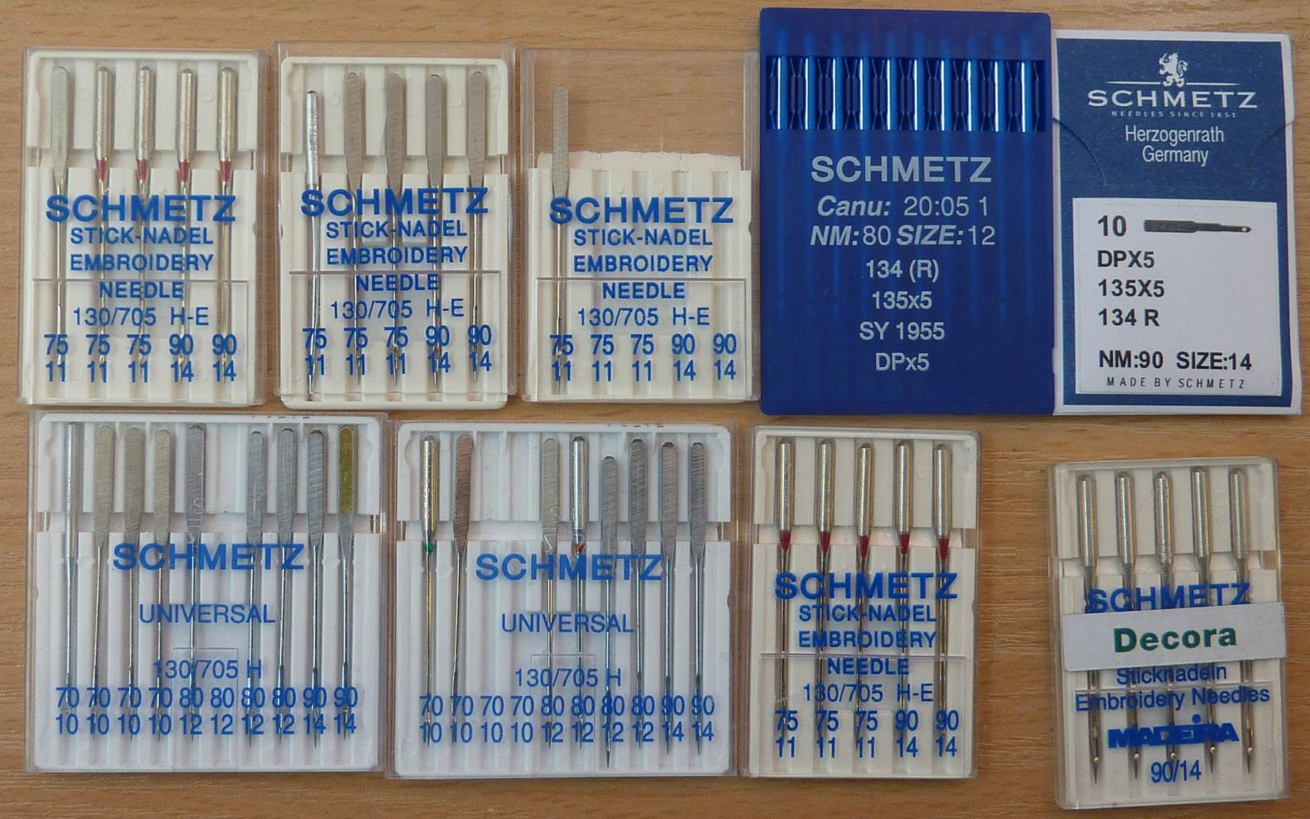
Sewing machine needles, Household
A normal sewing machine hook might hit the body of an embroidery needle
Industrial
Industrial

Slide 22
Sewing machine needles, Overlocker
Overlocker, Janome Mylock 644D
Manual: HA-1SP no.14 or no. 11. Eg. 90 or 75 size needle
HA-1SP is a normal houshold needle with Special Point (SP)

Slide 23
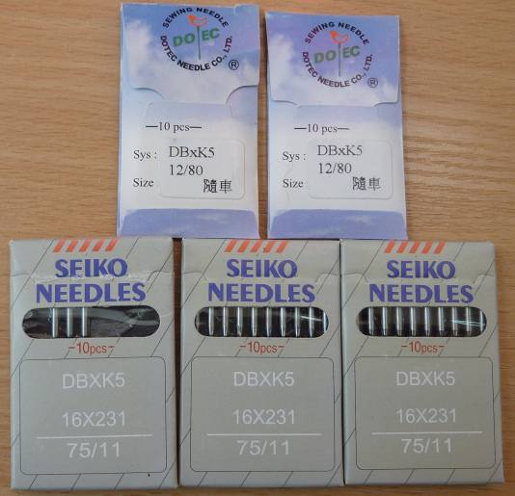
Sewing machine needles, Embroidery
Janome MB4 Embroidery Machine
Manual: DBXK5Q1-NY size 11 eg. NM75
Matching needle system names: DBXK5 DBX5 DBK5 ´ 135-5
134 R SY1955 16x231
Industrial needle with round shank

Slide 24
Sewing machine needles, Dürkopp 291
Manual names needle system: 2134-35
Matching needle system names: 134-35 2134-35 DPx35
Prefered needle sizes in machine: 80 to 140. Size 160 only to be used with extra precautions
We got these sizes now: Universal (R): 90, 100, 110, 120, 130, 140, and 160 Leather (LR): 110, 140, and 160
Industrial needle with round shank

Slide 25
Sewing machine needles, turn needle right
Look for the hook in machine and turn needle acording to that
Look at all sewing machines in room and identify hook
Oscillating hook – Double speed rotating hook
3 sewing machine needle sizes
Hook
Bottom of scarf

Slide 26
Sewing machine needles, Brands
Organ Household+Industrial (Japan)
Schmetz Household+Industrial (Original German)
Groz-Beckert Industrial (Original German)
Many other smaller brands: Orange, AMF, Klasse, Madeira, Bohin, Dotec, TNC, Flying Tiger, White Egret. (Singer, Bernina, Seiko)
Dont use: Flying Man.
Quality is about how smooth the needle eye is made

Slide 27
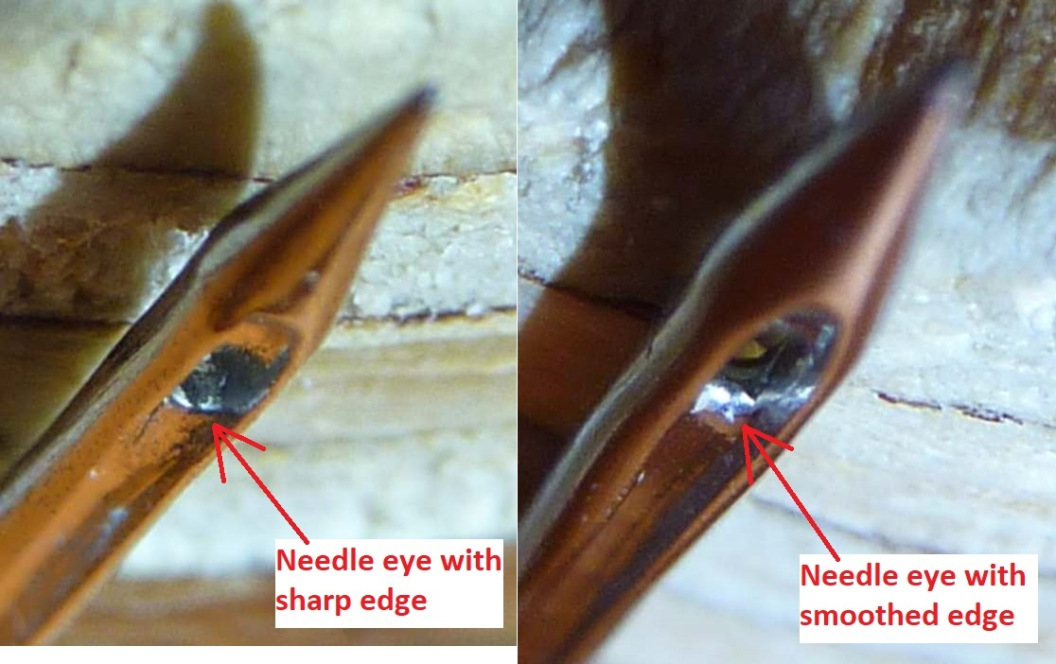
Sewing machine needles, Quality

Slide 28
Sewing machine preparations
Did you see the YouTube playlist?
Do you have comments – questions?
I will go through all controls and the checklist for the Dürkopp 291
One of you will control me with the shortform manual
Break 10 min

Slide 29
Sewing machine thread
Basic material(s)
Composition
Additives/coating
The colour and dye
Thickness
Make-up
Manufacturers
Many threads are for hand sewing only

Slide 30
Sewing machine thread material
Polyester Strong, durable, good UV-resistance
Nylon, Polyamid Stronger due to elongation, less UV-resistant, harder to make colors
Cotton Less strong, less UV resistant, nicer against skin, resist higher temperature. You can dye the thread with fabric.
Rayon, Viscose Less strong, bad to UV-light, sparkling colors
Silk Fair UV-resistance, nicer against skin.
Gore, Tenara Very good UV-resistance. Cost 1000 kr. For 200g

Slide 31
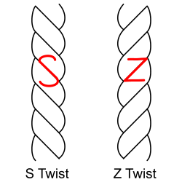
Sewing machine thread composition
3-Ply
3-Ply Corespun
Opposite twisting
Blending in
Friction
Strength
Against skin
Cotton spun
Flexibility
2-Ply Corespun
Not used

Slide 32
Sewing machine thread additives
Coating to improve UV-protection
Coating to improve durability (bonded thread)
Oils or coating for less friction in sewing machine

Slide 33
Sewing machine thread colour
The colour do influence the mechanical properties. A dark colour can be harder to work with. Thread tension can change by colour change.
A red colour faints faster than a blue colour at outdoor applications.
Normally thread manufacturers provide a colour card to order from. Amann Serafil threads are supplied in 240 colours.
To agree on a colour is difficult. It requires accurate measurement apparatus and calibration.

Slide 34
Sewing machine thread thickness
The received Tex value vary by production batch in range about -5% to +15%.
Minimum needle size is for soft light fabrics.
For heavy hard fabrics you will typically need to go up two needle sizes or more.

Slide 35




Sewing machine thread make-up
Issues about thread gets stuck and thread twisting
https://youtu.be/WHw8ZbyLlzQ&t=562

Slide 36
Sewing machine thread brands
Amann Reliable German brand. They got their own factories. https://www.amann.com/product-finder/
Gutermann They got a quality scheme specifications for factories around the world. They check the quality of thread and then the sellers are allowed to use the brand name with a fee to Gutermann.
Others A huge number of brands from around the world.

Slide 37
Sewing machines here exercise 2
Brother Innov-is 100 Group 2 & 4 Modern household zik-zak sewing machine with computer.
Veritas PowerStitch Pro Group 1 & 3 Modern household zik-zak sewing machine. Announced to be good for heavy duty applications.
Singer 201K, modified Group 4 & 2 Vintage straight stitch household sewing machine. Famous. Produced 1935 to 1961. This one is from 1950.
Dürkopp 291, new motor drive Group 3 & 1 Industrial triple feed sewing machine. Produced about 1985.

Slide 38
Sewing machines here exercise 2
What is a strong good-looking stitch?
The lock of the stitches should be near centre of the sewn fabrics. It is called a balanced stitch.
You should have equal length of the stitches.
Do the thread lay nice on the surface of the fabric?
When you lock the stitch in end of seam – do it look right?

Slide 39
Sewing machines here exercise 2
Needle should be 110 Universal, regular. Stitch length should be 4 mm.
Insert bobbin with Serafil 40 thread. It should already be there. Thread the machine with other color Serafil 40 thread until take-up lever.
Measure and set the upper thread tension to 2.5 Newton. Presser foot needs to be down.
Thread the rest of machine and pull up lower thread.
Measure and set lower thread tension to 0.35 Newton.
Sew two layers of tarpauline in repeated trials and adjust upper tension until you get a fair balanced stitch. Measure thread tension again.

Slide 40
Typical heavier fabrics
Discussion of different materials and fabrics in room

Slide 41
Sewing machines here exercise 3
Sew with Serafil 20 thread and 140/22 needles and only with the two heavy duty sewing machines.
Max thickness fabrics: Singer 201 – max 5 mm – try other presser foot too Durkopp 291 – max 10 mm
Thread tensions bobbin thread: 0.5 N (perhaps increase to 1 N)
Thread tension start: 8 N
Try to get a fair balanced stitch

